Slide 1

Hand Gesture Recognition
By Shitij Agrawal

Slide 2
INDEX
INTRODUCTION
COMPONENTS USED
IMPLEMENTATION AND WORKING
OUTPUT SCREEN-SHORTS
CONCLUSION

Slide 3
INTRODUCTION
IN TODAYS WORLD, WE HAVE CREATED LOTS OF SHORTCUT TECHNIQUES FOR OUR DAY-TO-DAY WORK LIKE DIGITAL ASSISTANT TO MANAGE OUR BASIC WORKS, CONTROLING HOME BY AUTOMATED WAY, ETC.
THE HAND GESTURE RECOGNATION CAN PROVIDE ONE OF SUCH WAY TO MAKE OUR DAY-TO-DAY LIFE EASY
HAND GESTURE RECOGNITION CAN ALSO BE VERY USEFUL FOR THE PEOPLES WHO HAS ANY KIND OF DISABILITY

Slide 4
Components used
PYTHON
MEDIAPIPE
OPENCV2
NUMPY
TENSORFLOW
SKLEARN
CSV

Slide 5
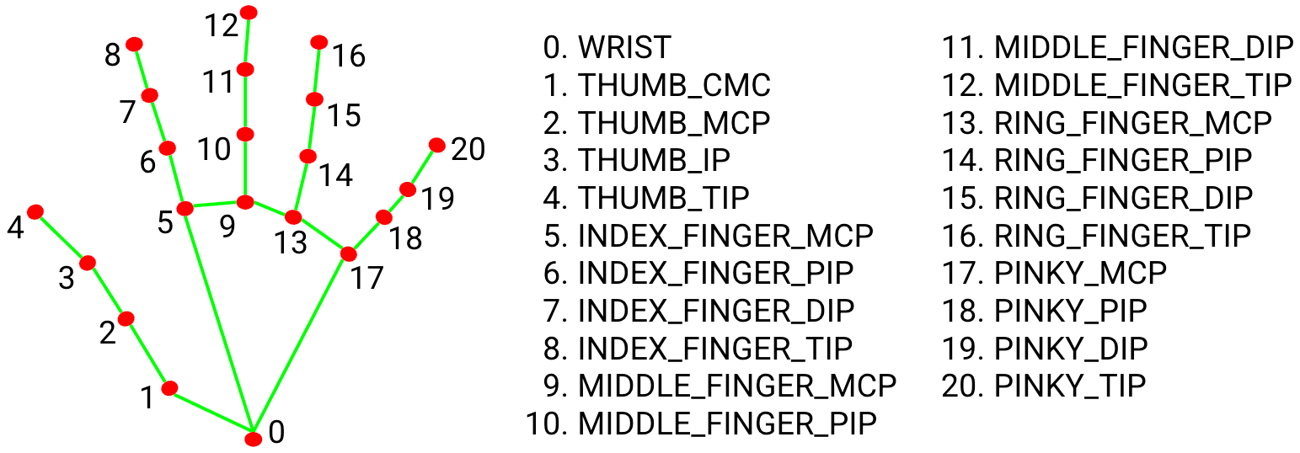
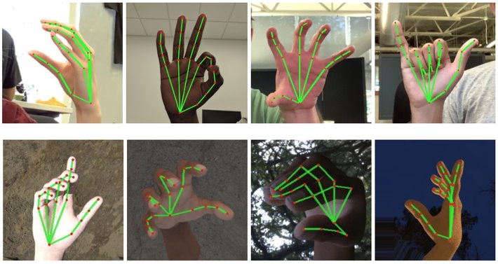
IMPLEMENTATION AND WORKING
To obtain ground truth data, ~30K real-world images with 21 3D coordinates are manually annotated , as shown below (taken Z-value from image depth map, if it exists per corresponding coordinate). To better cover the possible hand poses and provide additional supervision on the nature of hand geometry, we also render a high-quality synthetic hand model over various backgrounds and map it to the corresponding 3D coordinates.

Slide 6
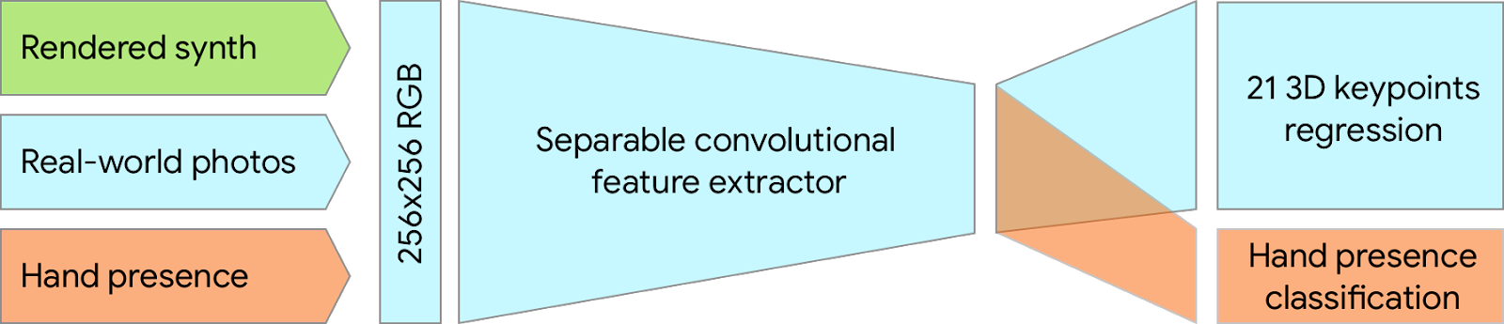
IMPLEMENTATION AND WORKING
Dataset | Mean regression error normalized by palm size
Only real-world | 16.1 %
Only rendered synthetic | 25.7 %
Mixed real-world + synthetic | 13.4 %
The table summarizes regression accuracy depending on the nature of the training data. Using both synthetic and real world data results in a significant performance boost.

Slide 7
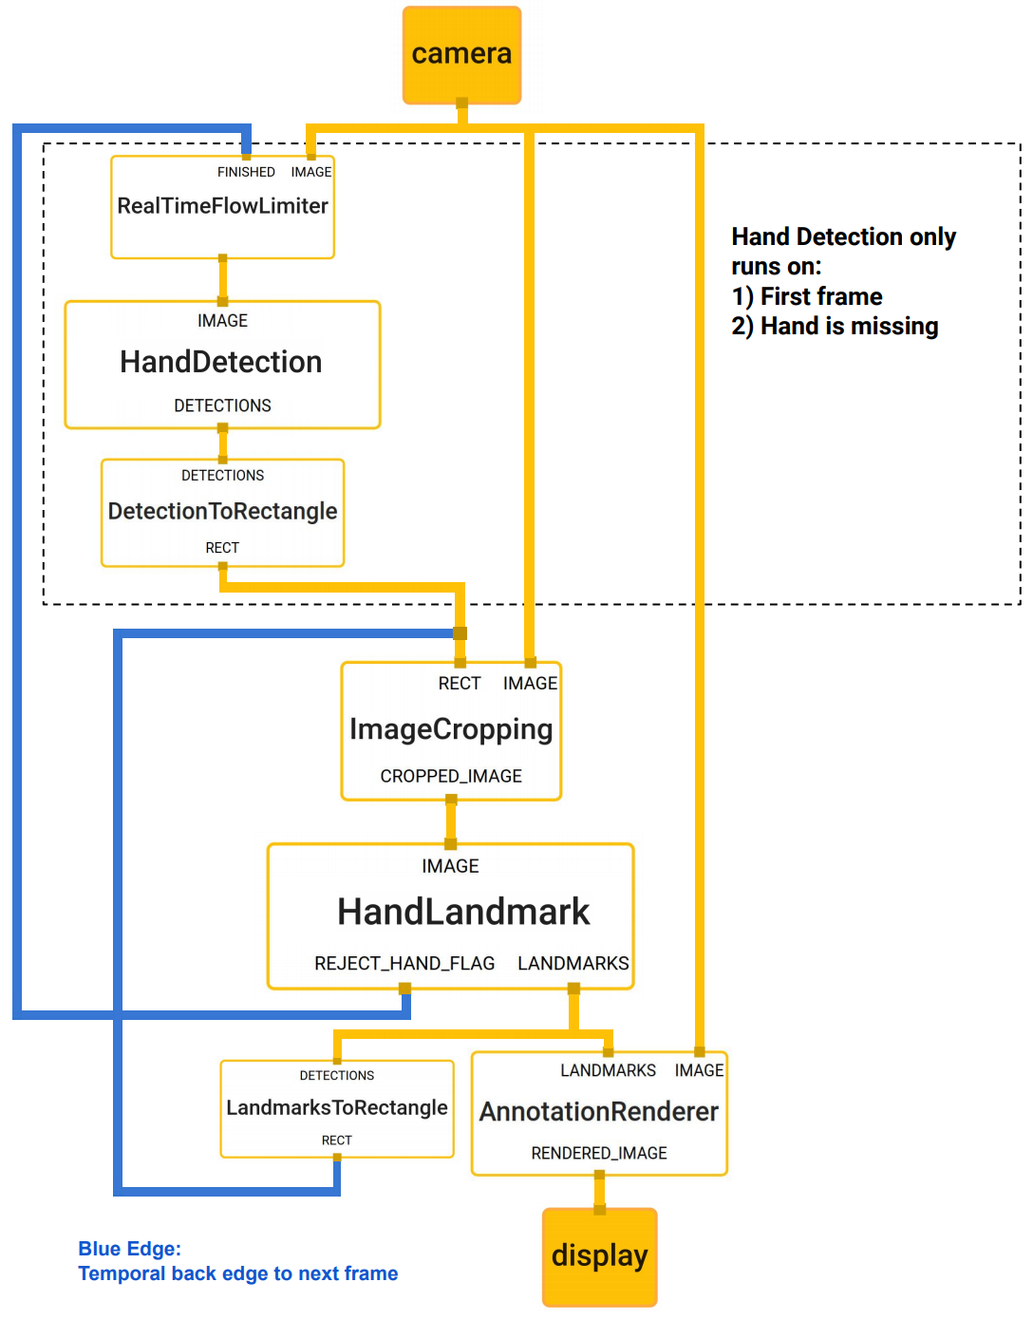
IMPLEMENTATION AND WORKING
The graph consists of two subgraphs—one for hand detection and one for hand keypoints (i.e., landmark) computation. One key optimization MediaPipe provides is that the palm detector is only run as necessary (fairly infrequently), saving significant computation time. We achieve this by inferring the hand location in the subsequent video frames from the computed hand key points in the current frame, eliminating the need to run the palm detector over each frame. For robustness, the hand tracker model outputs an additional scalar capturing the confidence that a hand is present and reasonably aligned in the input crop. Only when the confidence falls below a certain threshold is the hand detection model reapplied to the whole frame.

Slide 8
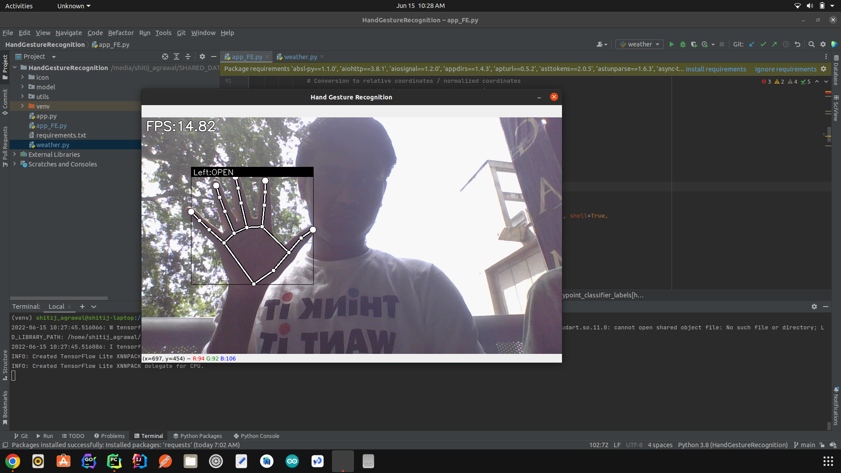
OUTPUT SCREEN SHORTS

Slide 9
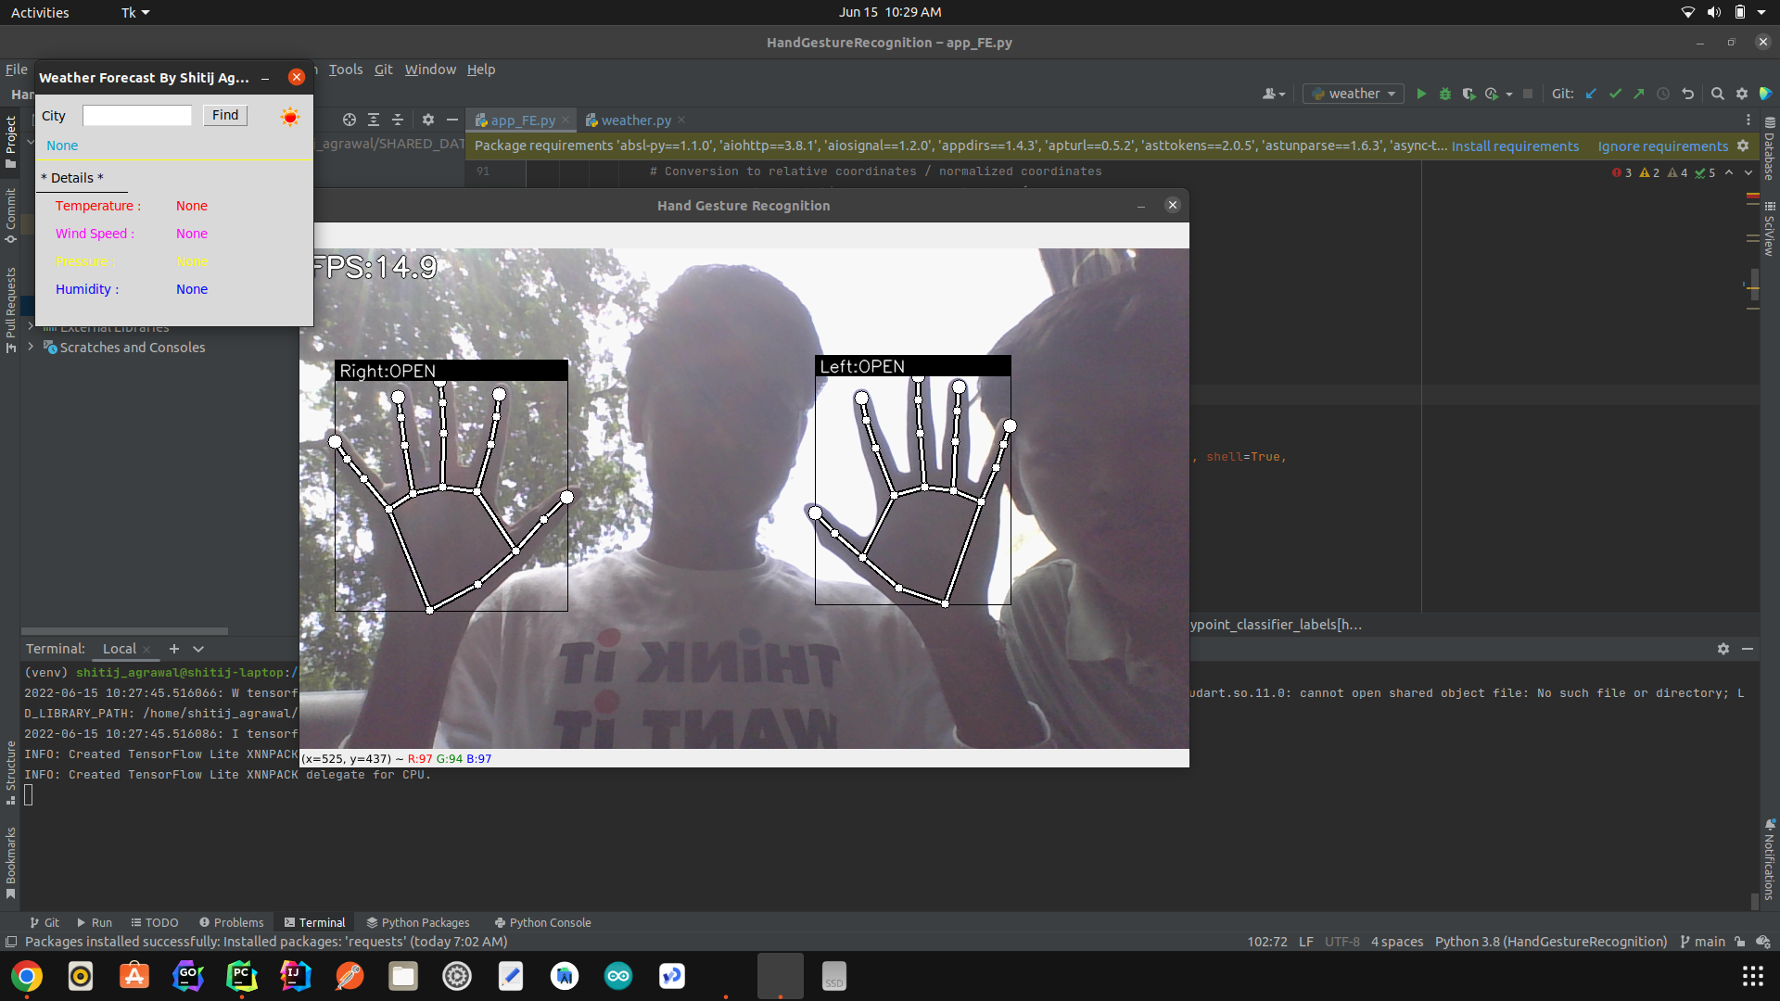
OUTPUT SCREEN SHORTS

Slide 10
CONCLUSION
THIS PROJECT CAN HELP TO MAKE LOTS OF APPLICATIONS RELATED TO THE HAND GESTURE
THIS IS A PORTABLE AND REUSABLE MODULE WHICH CAN BE EASILY REUSED IN MANY DIFFERENT PROJECTS

